Slide 1
Investigating the effects of birth order on mental well-being
Viet-Hung Nguyen
Department of Psychology
University of San Francisco
Spring & Fall 2024
Notes:
Ppl take personality tests
Guess zodiacs?

Slide 2
Birth order & personality
Sulloway (1996): family roles from competition for parental investment
First-borns follow parents’ footsteps, later-borns become rebels
=> Personality effects?
Inconsistent results
Notes:
We try to explain why things are the way they are
Birth order is your sibling rank in your family
In pop culture, birth order is a popular topic because we associate certain personalities with eldest siblings or youngest siblings
There’s the popular idea that eldest siblings are mature, more responsible. Younger siblings are rebellious, free
Indeed: Frank Sulloway 1996: idea about family roles due to the competition for parental investment
1st born: receive more attention from their parents at the beginning, so they follow their parents’ expectations and become better leaders conscientiousness
Later borns: would struggle with finding their own roles that weren’t already taken up => identify less with their parents/older siblings and become rebels and openness
Extensive research:
Inconsistent findings
Whether you use between-family or within-family design,

Slide 3
What about birth order & mental well-being?
Fullerton et al. (1989): male first-borns & poorer mental well-being
Fukuya et al. (2021): Tokyo later-borns & higher prosocial behavior, less conduct problems/hyperactivity
Lawson & Mace (2010): presence of older siblings => higher childhood mental health
Notes:
Not as much research, but the results are more one-sided
Fullerton et al 1989: 2,800 mostly males young adults
Male first-borns scored higher on a negative feelings subscale
Fukuya et al 2021: 3,000 Tokyo children age 9-10
Later-borns higher prosocial behavior, less conduct problems/less hyperactivity
Lawson & Mace 2010: presence of older siblings predicts higher childhood mental health

Slide 4
How does birth order impact mental well-being?
Older siblings provide socioemotional benefits
Older siblings are a secure base of attachment
=> cultural factors?
Notes:
(optional?)
Hypothesized mechanisms:
Older siblings give you social benefits
Early sibling interactions early on => thought regulation, understanding emotions.
Conflicts during playtime => prosocial behaviors (problem-solving, cooperation etc)
Using older siblings as a secure base of attachment complementary emotional caregiver
Flipside: => increased parental pressure, responsibility in older siblings
Alfred Adler’s dethronement theory: first-born jealousy after receiving less parental attention/interactions

Slide 5
My Study
Replicate the negative effects of birth order on mental well-being in adults, particularly in a sample with more women and people with immigrant backgrounds.
H1: Overall, first-borns will report lower mental well-being than later-borns.
H2: First-borns with immigrant backgrounds will report lower mental well-being than later-borns with immigrant backgrounds.
Notes:
Gaps/Questions left by the literature
=> adults. Women. Immigrants.
Replicate and explore the negative effects of birth order on aspects of mental well-being in young adults, particularly in a sample with more women and people with immigrant backgrounds.
H1: Overall, first-borns will report lower mental well-being than later-borns.
H2: First-borns with immigrant backgrounds will report lower mental well-being than later-borns with immigrant backgrounds.
Previous studies: less women, more children

Slide 6
My Study
2. Explore how birth order affects the different aspects of mental well-being.
Goodman et al. (2019): different psychological disorders => different impacts on mental well-being
=> intervention design
Notes:
Previous studies have not yet explored the different components of mental well-being and how they are affected by birth order.
This is important because: diff psych disorders experience different impacts on well-being (Goodman et al. 2019)
People with depression respond to negative events with less distress than healthy patients (verify)
Social anxiety disorder: experience chronically low levels of positive emotions
=> designing effective interventions for people with different conditions
It could be helpful to explore mental well-being & birth order
Perhaps diff aspects of mental well-being are affected differently by birth order

Slide 7
Aim 3: Examining Intersectionality
“A person’s multiple social identities interact and lead to unique opportunities and oppressions”
Multiple jeopardy hypothesis: interaction effect
Kern et al. (2020): SES, immigrant background, gender
Aim 3: To test the multiple jeopardy hypothesis with the factors of birth order, immigrant background, & gender on mental well-being.
Notes:
a person’s multiple social identities interact and lead to unique opportunities and oppressions. These are different compared to people who only identify with one of those identities
For instance, black women face forms of unique discrimination that are not experienced by white women or black men
Multiple jeopardy hypothesis: negative effect of being a member of multiple marginalized social groups is higher than the additive negative effect of all those social groups
It’s a multiplicative or interactive effect
Kern et al. (2020): on SES, immigrant background, and gender. Mental well-being
3 effects were additive and not interactive
My study will be looking at the factors of birth order, immigrant, gender
Why these 3?
All have a theme
Background of immigration & gender on mental well-being

Slide 8
Immigrant Background
Gender
Potential factors:
Academic achievement pressure
Family pressure
Potential Factors:
Domestic labor & family pressure
Notes:
(Immigrant paradox: (Alegria et al 2017))
Mental health issues become more common in the 2nd and 3rd generation (born in the new country)
Or cultural background:
Chinese-American example: academic achievement pressure (Kim et al., 2015)
One of the earlier studies i talked about took place in tokyo
Stated: first-borns are required to behave more mature and responsible while taking care of younger siblings
Gender: women report higher anxious/depressive symptomatology

Slide 9
Aim 3: To test the multiple jeopardy hypothesis with the factors of birth order, immigrant background, & gender on mental well-being.
H3: Immigration background and gender moderate the negative effect of birth order on mental well-being; first-born daughters with immigrant backgrounds will report the lowest mental well-being out of all groups.
Immigration background
Mental
well-being
Birth order
Gender
Notes:
So:
All 3 of these involve some sort of family pressure whether in the form of caretaking, domestic labor, or academic achievement
Possible that these effects interact and amplify each other.
Recap:
Aim 1: replicate the birth order effect
Aim 2: explore diff aspects of mental well-being

Slide 10
Methods (15-20min Qualtrics Survey)
Notes:
Gen psyc pool

Slide 11
Ryff Psychological Well-Being Scale
Autonomy: “I have confidence in my opinions, even if they are contrary to the general consensus”
Environmental mastery: “In general, I feel I am in charge of the situation in which I live”
Personal growth: “I think it is important to have new experiences that challenge how you think about yourself and the world”
Positive relations with others: “People would describe me as a giving person, willing to share my time with others”
Purpose in life: “Some people wander aimlessly through life, but I am not one of them”
Self-acceptance: “When I look at the story of my life, I am pleased with how things have turned out”
Ryff PWB
Notes:
Has been validated in adults of all ages, students, people from lower incomes, as well as Asian international students and Latinos
42-item, 7-point Likert scale

Slide 12
PHQ-8
“Little interest or pleasure in doing things”
“Feeling tired or having little energy”
etc.
GAD-7
“Feeling nervous, anxious, or on edge
“Trouble relaxing”
etc.
Ryff PWB
PHQ-9
GAD-7
Demographics
Notes:
2 quick proxies for depression and anxiety
PHQ-9
GAD-7
Both used in a lot of clinical settings
Over the last two weeks, how often have you been bothered by the following problems?
4-point Likert Scale

Slide 13
What did we find?

Slide 14
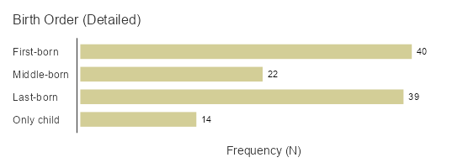
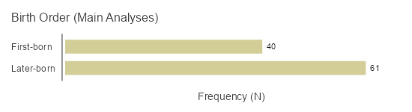
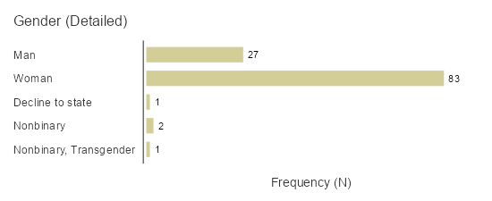
Descriptives
14
Notes:
Descriptives first.
Participant profile:
N = 115 participants. Mostly USF
Age range: 18-26, but the overwhelming majority was 18-21 y/o.
Birth order:
Quite balanced split within the people that had siblings.
For my main hypotheses, I divide birth order in to just first-born vs later-borns (and excluded only children)
But I included the only children
Highlight Part of my aim 1: collect a sample with more women and people of immigrant backgrounds compared to previous studies, which I believe i have accomplished.
The participant pool essentially reflected the typical Gen Psych pool.
Gender: mostly women
Not a lot of men, which makes it a bit difficult to test my hypotheses, but we’ll look at that later

Slide 15
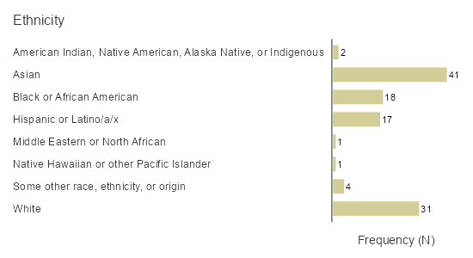
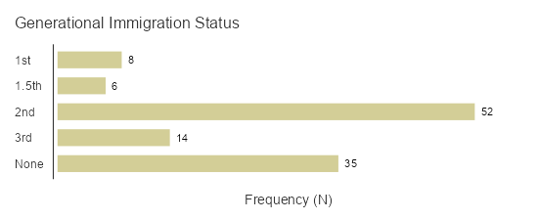
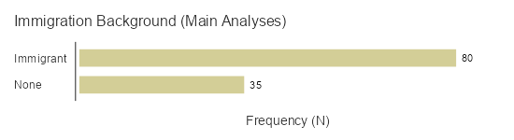
Descriptives
15
Notes:
Likewise for the ethnicity and generational immigration status,
What does this show us?
With a sample of 115 participants, I was able to capture a decent diversity of students?
Of course, cultures vary a lot among ethnicities etc, but this gives us a decent snapshot of the population in Gen Psyc
One of our goals was to recruit more women and people of immigrant background
=> filled a gap. Success.

Slide 16
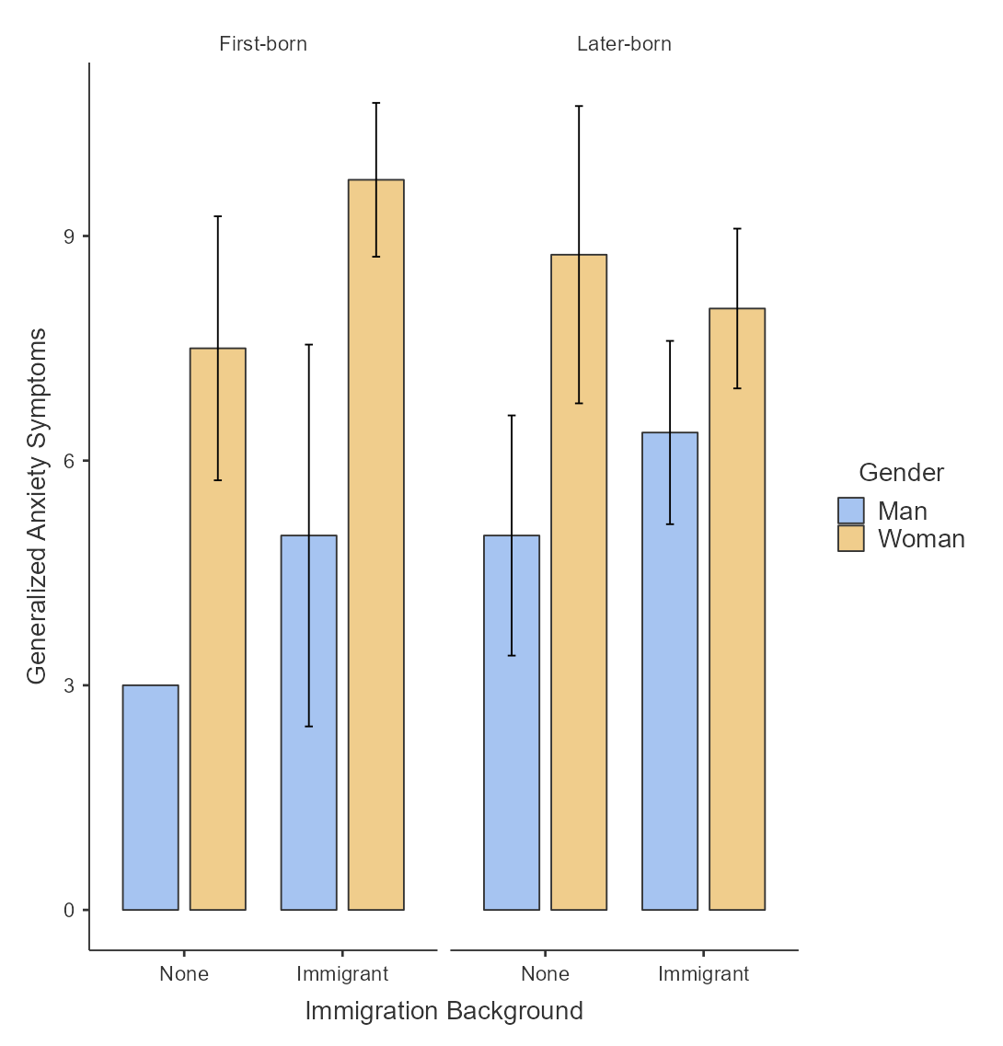
Notes:
So here would be full breakdown of one of my well-being measures based on birth order, gender, and immigrant background.
It’s a lot, so let’s collapse it and look at our first hypothesis first:
H1:

Slide 17
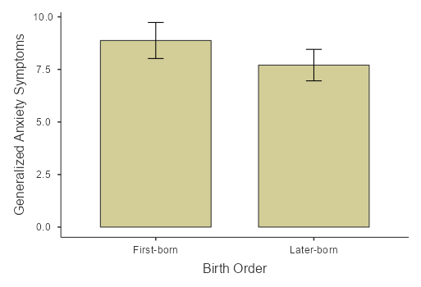
H1: Among people with siblings, do first-borns have lower mental well-being than later-borns?

Slide 18
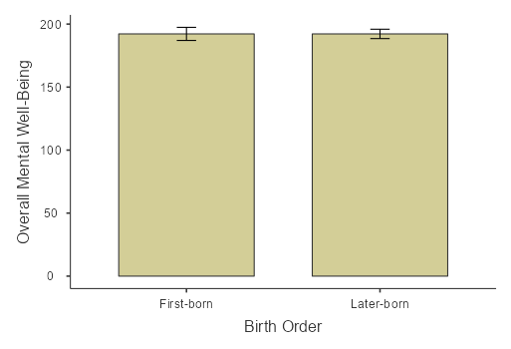
H1: Among people with siblings, do first-borns have lower mental well-being than later-borns?
Notes:
Excel graph.
So here would be full breakdown of one of my well-being measures based on birth order, gender, and immigrant background.
It’s a lot, so let’s simplify it and look at our first hypothesis first:
H1:
H2: i don’t have the graphs pictured here, but they are very similar.
No
First let’s look at potential effects:
1. we already looked at the main effect of birth order in the last slide, we collapsed the first-borns together and the later-borns together, and saw no significant difference.
My hypothesis was that the negative effects of being a first-born, woman, and having an immigrant background would compound on mental well-being.
So, we are looking to see if the first-born immigrant women would have much anxiety symptoms than later-born non-immigrant men.

Slide 19
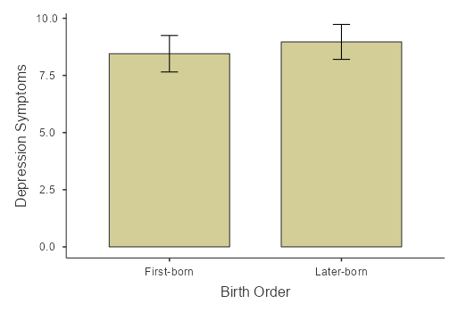
H1: Among people with siblings, do first-borns have lower mental well-being than later-borns?

Slide 20

H2: Among people with immigrant backgrounds and siblings, do first-borns have lower mental well-being than later-borns?

Slide 21
H3: Is there an interaction between the effects of birth order * gender * immigrant background on mental well-being?
Gender effect size:
Cohen’s d = -.64
p = .006
Notes:
So we weren’t able to find the main effect of birth order
No
First let’s look at potential main effects:
1. we already looked at the main effect of birth order in the last slide, we collapsed the first-borns together and the later-borns together, and saw no significant difference.
-------------------------------------
Test multiple jeopardy hypothesis
My hypothesis was that the negative effects of being a first-born, woman, and having an immigrant background would compound on mental well-being.
(POINT) So, we are looking to see if the first-born immigrant women would have much more anxiety symptoms than later-born non-immigrant men.
But, main gender effect!
Effect size: -0.6 medium

Slide 22
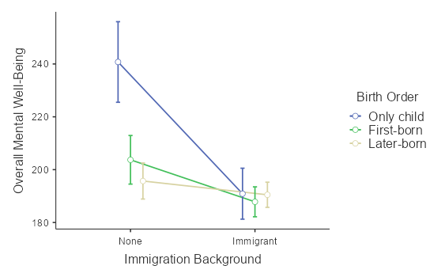
Among all participants (incl. only children), is there an interaction effect of birth order * immigrant background?
Immigrant background effect:
Cohen’s d: .78
p = .002
Notes:
Among all:
PREFACE: 14 only children
Main effect of immigrant background on MWB
Driven by what looks like an interaction between birth order * immigrant background.
That goes against our intuition/popular idea, right? About only children
14 only children
There were 4 non-immigrant only children ,
This is very interesting.
I wanted to Zoom in on that sample a little

Slide 23
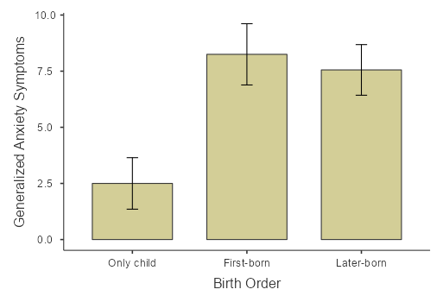
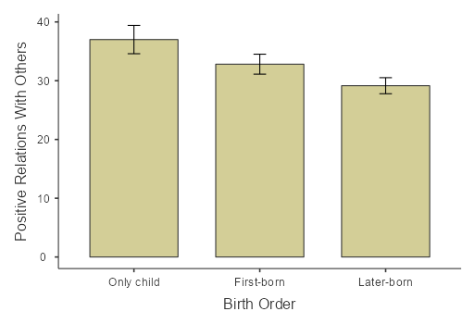
Birth order effects on people with none or 3rd-gen immigrant background
p = .006 p = .036
Notes:
For this, I also added 3rd-gen immgirants.
Because if ~1 of your grandparents was an immigrant, perhaps you are culturally no longer as closely related to those cultural factors that affect mental well-being anymore.
GAD:
Only child vs both first/later-borns
PosRelations:
Only child vs later-borns.
This scale is one of the subscales

Slide 24
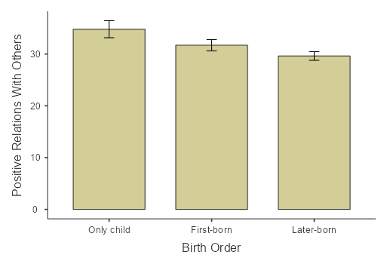
Aim 2: Explore how birth order affects different aspects of mental well-being
Autonomy
Environmental Mastery
Personal Growth
Positive Relations With Others
Purpose In Life
Self-Acceptance
Cohen’s d: .78 p = .027
Notes:
Exploratory:
This finding held up in the entire sample as well.
The Positive Relations could drive/impact the increased MWB in only children?

Slide 25
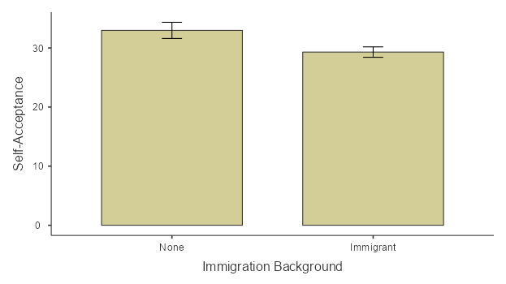
Among everyone (incl. only children), does immigrant background affect mental well-being subscores?
Cohen’s d: .462 p = .025

Slide 26
What do we make of this?
Main hypotheses unsupported
Gender effect on anxiety symptoms
Notes:
Immigration important?

Slide 27
Only children might be displaying higher mental well-being. (Positive Relations With Others)
…but only among non-immigrants? (Anxiety Symptoms, Positive Relations With Others, Self-Acceptance)
Notes:
Birth order: not rly, but only children may be doing better than expected.
Driven by: Positive Relations with others compared to later-borns and maybe first-borns too
Driven by: more positive relations with others in None/3rd gen: and the only children have less anxiety,
Interaction: but they only do better if they’re non-immigrants
Non-immigrants have more self-acceptance than people with immigrant backgrounds
Future Directions:
Look at only children with larger sample and incl. immigrants. Subscores
Look for that interaction.
Especially look to see if that benefit is only limited to Non-immigrants. Is it driven by self-acceptance?
Limitation:
Small only child sample size
For interaction
Look at immigration.
Retrospect: look at what defines immigration.
Maybe acculturation?
Parent-child acculturation?
More deeper
Overall, this pattern of exploratory findings is promising.

Slide 28
Thank you!
Questions?
I would like to extend my deepest gratitude to:
Dr. Viskontas, Dr. Levy, our thesis cohort, Dr. Reese, current & former members of the Learning & Memory Lab, family & friends, the USF Psychology Faculty & Program Assistant.
I would also like to thank Dr. Joshi, Dr. Munnich, & Dr. Chun.
Notes:
Mentorship, additional guidance.

Slide 29
Appendix

Slide 30
Birth Order
First-born vs last-born (& middle-born)
Sulloway (1996): family roles from competition for parental investment
First-borns follow parents’ footsteps, later-borns become rebels
=> Personality effects
Notes:
Birth order is your sibling rank in your family
In pop culture, birth order is a popular topic because we associate certain personalities with eldest siblings or youngest siblings
There’s the popular idea that eldest siblings are mature, more responsible. Younger siblings are rebellious, free
Indeed: Frank Sulloway 1996: idea about family roles due to the competition for parental investment
1st born: receive more attention from their parents at the beginning, so they follow their parents’ expectations
Later borns: would struggle with finding their own roles that weren’t already taken up => identify less with their parents/older siblings and become rebels
=> his theory was about birth order and the effects of personality, to be specific
There have been many studies conducted on this
Swedish study (Black et al 2018) : 36,000
First-born males: more emotionally stable, persistent, socially outgoing, took more initative
First-born children: managers and leadership positions
Some other studies with similar effects
Healey & Ellis 2006: first-borns had higher conscientiousness and 2nd-borns are more open to new experiences and are more rebellious
Dixon et al 2008: later borns extraverted
A lot of studies were not able to find personality effects.
1983 Ernst & Angst: most personality effects were confounded with SES and family size
Most studies used between-family designs: Get a bunch of first-borns, last-borns, etc. compare them to each other since they probably come from diff families.
A number of studies have been conducted using within-family desigsn: compare the siblings to each other
Some found effect, some not
Yes (Healey & Ellis, 2006;
No (Bleske-Rechek & Kelley 2013) Rohrer et al 2015) Olneck & Bills 1979)
1 study used both designs => no effect. (20,000 people)
=> current effect: mixed/inconsistent, no matter what design you use. On personality

Slide 31
Birth Order & Personality Effects
Black et al. (2018): first-borns & leadership
Healey & Ellis (2006):
first-borns & conscientiousness
2nd-borns & openness, rebelliousness
Dixon et al (2008): later-borns & extraversion
Notes:
Birth order is your sibling rank in your family
In pop culture, birth order is a popular topic because we associate certain personalities with eldest siblings or youngest siblings
There’s the popular idea that eldest siblings are mature, more responsible. Younger siblings are rebellious, free
Indeed: Frank Sulloway 1996: idea about family roles due to the competition for parental investment
1st born: receive more attention from their parents at the beginning, so they follow their parents’ expectations
Later borns: would struggle with finding their own roles that weren’t already taken up => identify less with their parents/older siblings and become rebels
=> his theory was about birth order and the effects of personality, to be specific
There have been many studies conducted on this
Swedish study (Black et al 2018) : 36,000
First-born males: more emotionally stable, persistent, socially outgoing, took more initative
First-born children: managers and leadership positions
Some other studies with similar effects
Healey & Ellis 2006: first-borns had higher conscientiousness and 2nd-borns are more open to new experiences and are more rebellious
Dixon et al 2008: later borns extraverted

Slide 32
Does birth order really affect personality?
Ernst & Angst (1983): personality confounded with SES/family size (between-family designs)
Do within-family designs show an effect?
Yes: Healey & Ellis (2006)
No: Bleske-Rechek & Kelley (2013); Rohrer et al. (2015)
Notes:
A lot of studies were not able to find personality effects.
1983 Ernst & Angst: most personality effects were confounded with SES and family size
Most studies used between-family designs: Get a bunch of first-borns, last-borns, etc. compare them to each other since they probably come from diff families.
A number of studies have been conducted using within-family desigsn: compare the siblings to each other
Some found effect, some not
Yes (Healey & Ellis, 2006;
No (Bleske-Rechek & Kelley 2013) Rohrer et al 2015) Olneck & Bills 1979)
1 study used both designs => no effect. (20,000 people) (Bleske-Rechek 2013
=> current effect: mixed/inconsistent, no matter what design you use. On personality

Slide 33
Immigrant background
“Healthy migrant effect”: foreign-born vs native-born physical health
Mental health issues in 2nd- and 3rd-generation immigrants
Academic achievement pressure
Family pressure
Notes:
Healthy migrant effect: foreign-borns have higher (physical health) than native-borns (Ali, 2002)
Selection bias? Those who immigrate are more resilisent
But migration is still stressful (esp. women)
Stigma
Immigrant paradox: (Alegria et al 2017)
Mental health issues become more common in the 2nd and 3rd generation (born in the new country)
Or cultural background:
Chinese-American example: academic achievement pressure (Kim et al., 2015)
One of the earlier studies i talked about took place in tokyo
Stated: first-borns are required to behave more mature and responsible while taking care of younger siblings

Slide 34
Gender
Anxious & depressive symptomatology
Pressure for domestic labor & family responsibilities
Notes:
women are persistently under pressure to cater to domestic labor and other family responsibilities that can generate significant amounts of stress, especially in conjunction with work commitments (Austen & Birch 2000)

Slide 35
Methods
100 General Psychology students
15-20 min. Qualtrics survey

Slide 36
Data Analysis Plan
α level: .01667
H1 and H2 (comparing first-born vs later-born mental health): T-Test
H3 (multiple jeopardy hypothesis): Three-Way ANOVA
Tukey’s post hoc test
Controlling for SES: ANCOVA

Slide 37
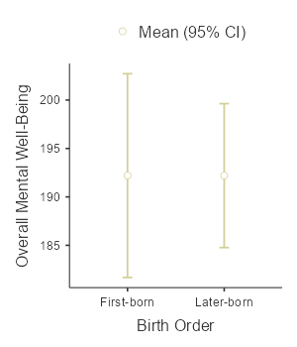
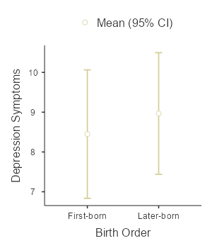
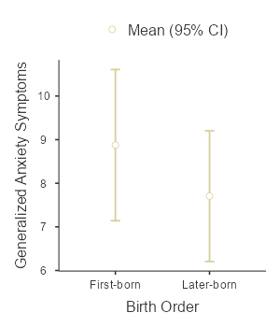
H1: Among people with siblings, do first-borns have lower mental well-being than later-borns?
H2: Among people with immigrant backgrounds and siblings, do first-borns have lower mental well-being than later-borns?
Notes:
Main Analyses
H1:
For h2, result was very similar. No significant differences.
Note: PHQ, GAD symptoms were high (mild anxiety/depression)

Slide 38
Predictions

Slide 39
What about birth order & mental well-being?

Slide 40
Agenda
Introduction
Building confidence
Engaging the audience
Visual aids
Final tips & takeaways

Slide 41

The power of communication

Slide 42

Overcoming nervousness
Confidence-building strategies

Slide 43
Engaging the audience
Make eye contact with your audience to create a sense of intimacy and involvement
Weave relatable stories into your presentation using narratives that make your message memorable and impactful
Encourage questions and provide thoughtful responses to enhance audience participation
Use live polls or surveys to gather audience opinions, promoting engagement and making sure the audience feel involved

Slide 44
Selecting visual aids
Enhancing your presentation

Slide 45
Effective delivery techniques
This is a powerful tool in public speaking. It involves varying pitch, tone, and volume to convey emotion, emphasize points, and maintain interest.
Pitch variation
Tone inflection
Volume control
Effective body language enhances your message, making it more impactful and memorable.
Meaningful eye contact
Purposeful gestures
Maintain good posture
Control your expressions

Slide 46
Navigating Q&A sessions
Know your material in advance
Anticipate common questions
Rehearse your responses
Maintaining composure during the Q&A session is essential for projecting confidence and authority. Consider the following tips for staying composed:
Stay calm
Actively listen
Pause and reflect
Maintain eye contact

Slide 47

Speaking impact
Your ability to communicate effectively will leave a lasting impact on your audience
Effectively communicating involves not only delivering a message but also resonating with the experiences, values, and emotions of those listening

Slide 48
Dynamic delivery
Learn to infuse energy into your delivery to leave a lasting impression
One of the goals of effective communication is to motivate your audience
Metric | Measurement | Target | Actual
Audience attendance | # of attendees | 150 | 120
Engagement duration | Minutes | 60 | 75
Q&A interaction | # of questions | 10 | 15
Positive feedback | Percentage (%) | 90 | 95
Rate of information retention | Percentage (%) | 80 | 85

Slide 49
Final tips & takeaways
Consistent rehearsal
Strengthen your familiarity
Refine delivery style
Pacing, tone, and emphasis
Timing and transitions
Aim for seamless, professional delivery
Practice audience
Enlist colleagues to listen & provide feedback
Seek feedback
Reflect on performance
Explore new techniques
Set personal goals
Iterate and adapt

Slide 50
Speaking engagement metrics
Impact factor | Measurement | Target | Achieved
Audience interaction | Percentage (%) | 85 | 88
Knowledge retention | Percentage (%) | 75 | 80
Post-presentation surveys | Average rating | 4.2 | 4.5
Referral rate | Percentage (%) | 10 | 12
Collaboration opportunities | # of opportunities | 8 | 10

Slide 51
Thank you
Brita Tamm
502-555-0152
brita@firstupconsultants.com
www.firstupconsultants.com

